Slide 1

Implementation of 5G Stand Alone Network
Utilizing Open5gs and UERANSIM
Mobile Computing WS2023/24 Project
Guided by : Prof. Dr. Armin Lehmann
Team members:
Padmini Manjunatha 1427336
Kushal Prakash 1429800
Karthik Kothamangala Sreenath 1438341
Madhushree Manjunatha Lakshmidevi 1445185

Slide 2
Agenda
Project Roadmap
Introduction to 5G Standalone Architecture
5G Evolution
Importance and Key features of 5G technologies
Key components and features of 5G
Network Slicing
Open5gs and UERANSIM
Network Architecture
Practical Demonstration of the services used
Conclusion

Slide 3
Project Roadmap
Sprint 1: Setup and Resource Collection (Dec 4 -17)
Sprint 2: Environment Setup and Initial Testing (Dec 18 – 31)
Sprint 3: Core Installation and Configuration (Jan 1 – 14)
Sprint 4: Network Slicing and Architecture Design (Jan 15 -28)
Sprint 5: Service Integration and Documentation (Jan 29 – Feb 11)
Sprint 6: Final Testing and Project Presentation (Feb 12 – 25)

Slide 4
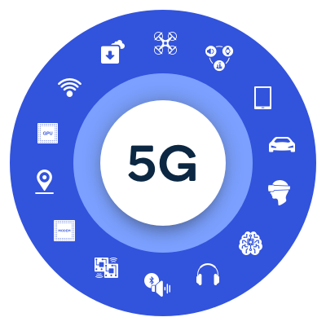
Introduction
The 5G Standalone Standalone architecture is a next-generation network framework designed exclusively for 5G. Unlike the Non-Standalone (NSA) architecture, which relies on existing 4G LTE networks, the SA architecture operates independently, leveraging a fully 5G core network. This independence allows it to fully utilize 5G's capabilities, including enhanced speeds, reduced latency, and increased capacity.

Slide 5
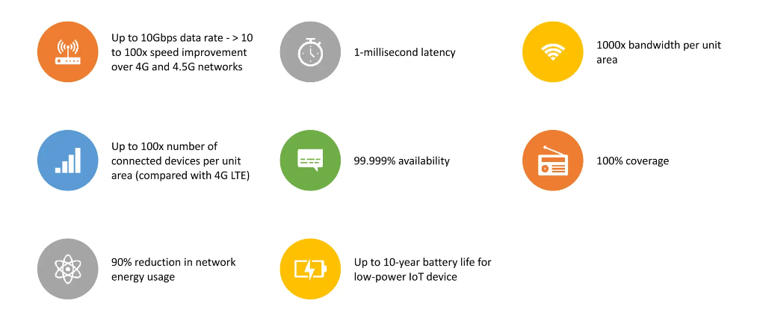
Key features of 5G technology

Slide 6
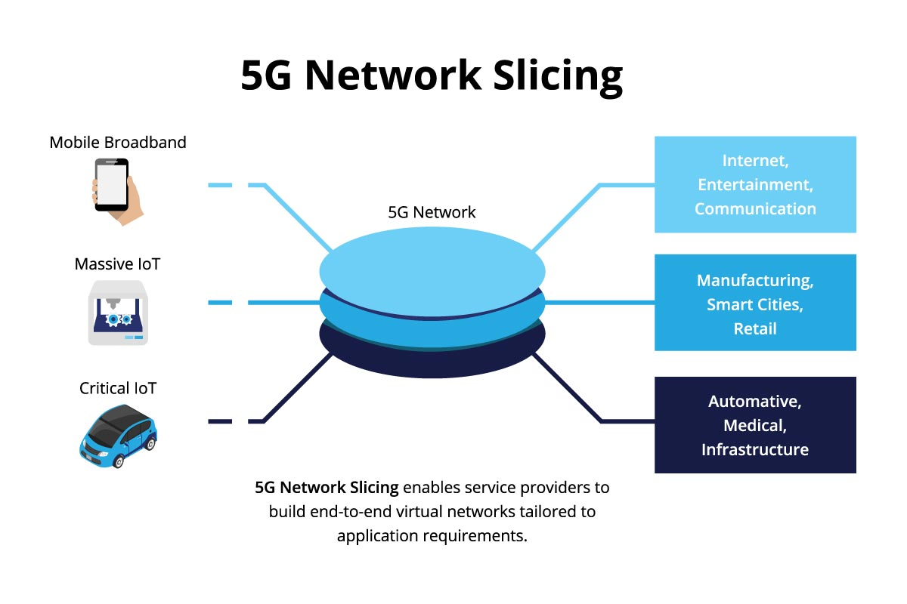
Network Slicing
What is Network slicing?
Network slicing is a form of network virtualization that allows for the creation of multiple distinct, logical networks, each optimized for a specific type of service or customer requirement, over a common physical infrastructure.

Slide 7

Overview of Open5gs
Open-Source Framework: Open5GS is a pioneering open-source project aimed at implementing core network functions for 5G and 4G (LTE) networks.
Facilitating 5G R&D: Provides a comprehensive framework for deploying a fully operational core network, crucial for the research, development, and testing of 5G technologies.
Enabling Flexibility: Acts as a flexible and adaptable core network solution pivotal for the deployment of 5G Standalone (SA) architecture.
Scalability: Designed for scalability, it supports various network sizes, from small experimental setups to large, complex environments.

Slide 8

Overview of UERANSIM
Simulation Tool: UERANSIM is a powerful open-source simulator for 5G networks, specifically designed to emulate the user equipment (UE) and the gNodeB (gNB) components.
5G Network Support: Plays a crucial role in the testing and development of 5G Standalone networks by providing a realistic and flexible simulation environment.

Slide 9
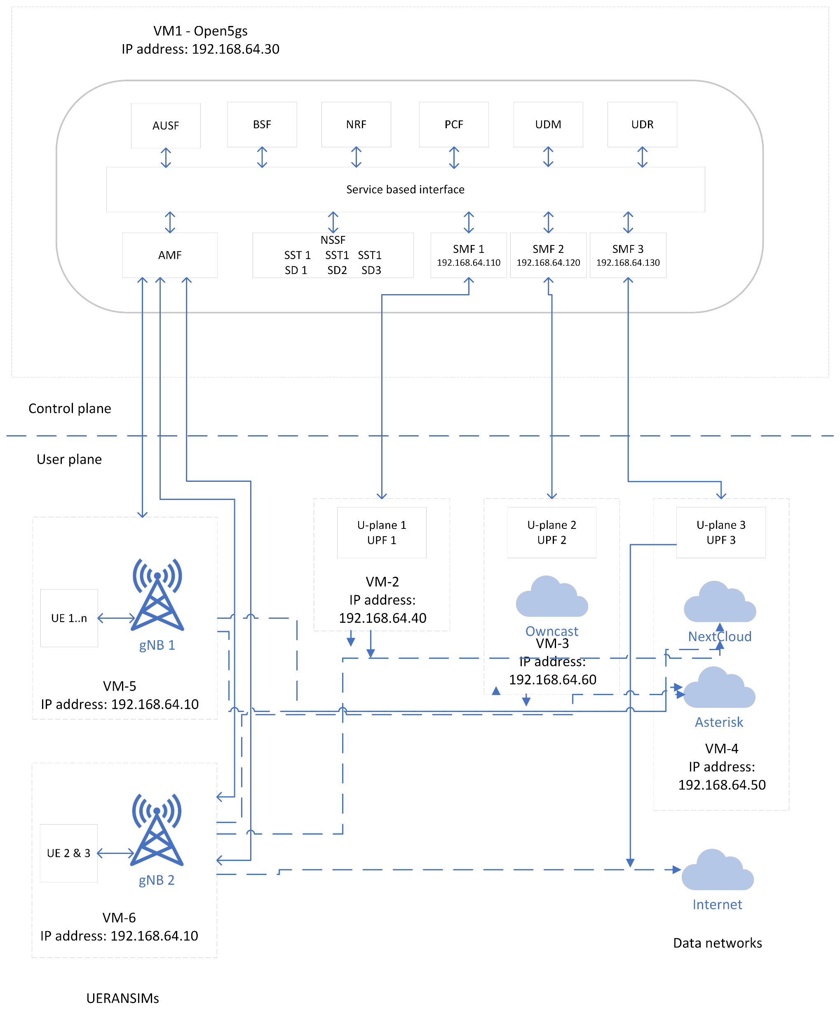
Network Architecture

Slide 10
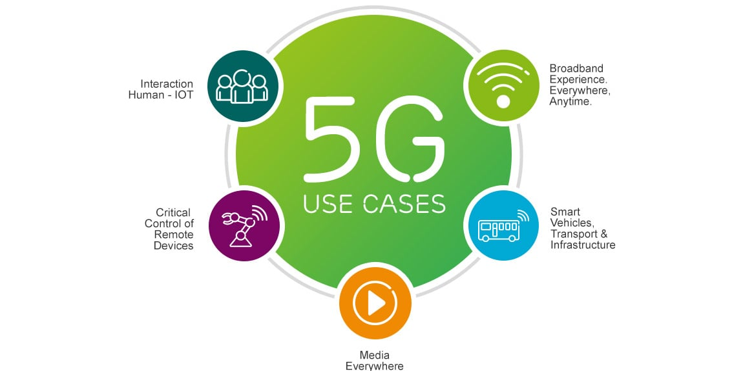
Services:
Voice over Internet Protocol (VoIP)
File sharing (Next cloud)
Video streaming
Internet

Slide 11

VoIP (Voice over Internet Protocol)
This is a technology that allows voice communication and multimedia sessions over Internet Protocol (IP) networks, such as the internet or other packet-switched networks.
VoIP services are expected to improve significantly due to the enhanced capabilities of 5G networks
Higher Bandwidth
Lower Latency
Increased Connectivity
Improved Mobility

Slide 12

File sharing – Next cloud
Nextcloud is a versatile open-source file sharing and collaboration platform that is well-suited to be part of a 5G network infrastructure, leveraging the enhanced capabilities of 5G to offer users a seamless file-sharing experience.

Slide 13
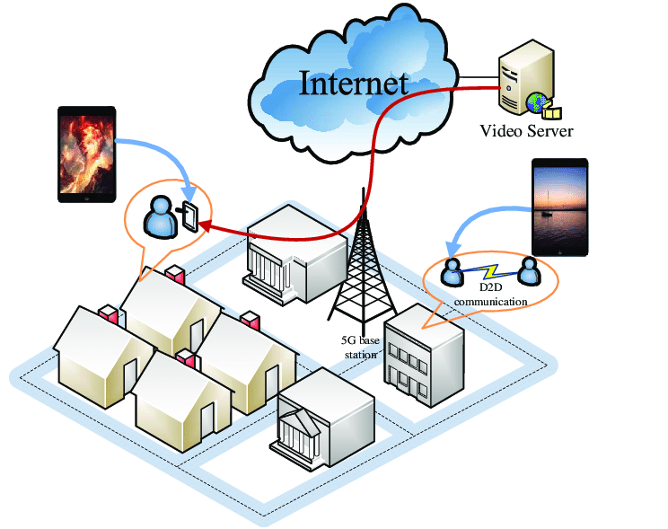
Video streaming
Video streaming services in 5G networks represent a significant leap forward from previous generations, offering unprecedented improvements in speed, efficiency, and user experience.

Slide 14

Internet Service
Using the internet on a 5G network enables unprecedented high-speed access and seamless connectivity, enhancing digital communication and internet usage in modern, connected societies across various devices.

Slide 15

CONCLUSION
The project showcases the transformative potential of 5G in enhancing VoIP, file sharing, and video streaming services, using advanced platforms and network slicing for optimized performance and scalability. This highlights 5G's role in revolutionizing digital communication and data sharing.

Slide 16
Demo

